Slide 1
World Aviation Conference 2025
Future Air Travel Experiences Leveraged by Technology
September 3, 2025

Slide 2

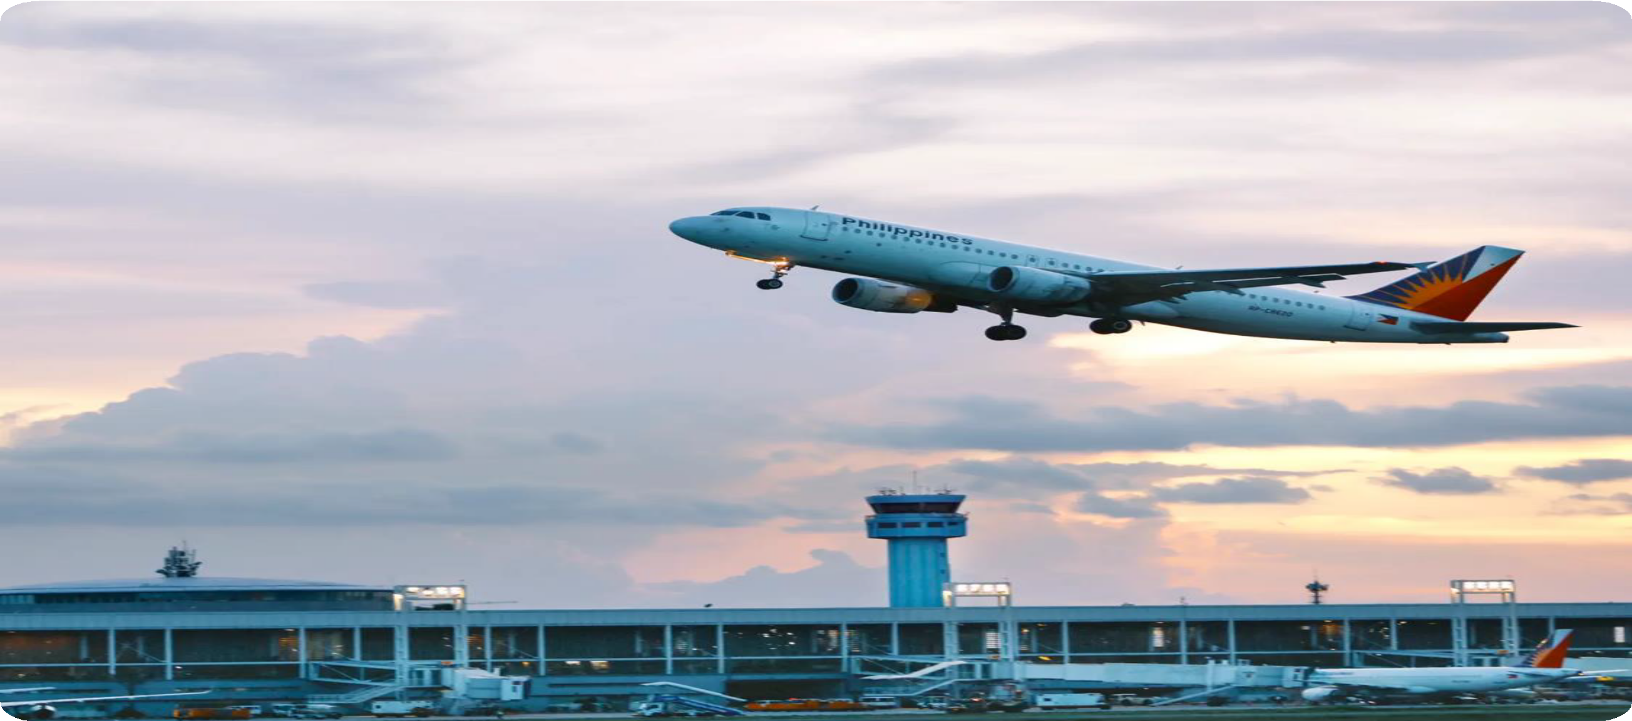
37
Snapshot of NAIA
53.4 million
Projected No. of Passengers for 2025
TH
BUSIEST AIRPORT IN
THE WORLD
50.12
MILLION ANNUAL PAX
2024

Slide 3







Snapshot of NAIA
145K Pax/Day
826 Flights/Day
17.3 M
INTERNATIONAL
90.3K
INTERNATIONAL
135.6K
DOMESTIC
PAX
FLIGHTS
20.1 M
DOMESTIC
79.9%
ON-TIME PERFORMANCE
70
INTERNATIONAL DESTINATIONS
37
DOMESTIC DESTINATIONS

Slide 4



Snapshot of NAIA
40 Foreign Airlines
7 Domestic Carriers
T1
(International)
20 AIRLINES
10 MAP
T2
(Domestic)
4 AIRLINES
14 MAP
T3
(Combined)
23 AIRLINES
26.1 MAP

Slide 5




2024 PASSENGERS, ATM & CARGO
TOTAL ACTUAL PAX IN 2024
50.12M
293.5K
NAIA DESIGN CAPACITY
35 M
114.7K
INTERNATIONAL
178.8K
DOMESTIC
FLIGHTS
15.12 M more than the design capacity
616.4K
23.27 M
26.85 M
404.5K
INTERNATIONAL
211.9K
DOMESTIC
INTERNATIONAL
DOMESTIC
CARGO
IN METRIC TONNES
Notes:
ADD TOTALS

Slide 6

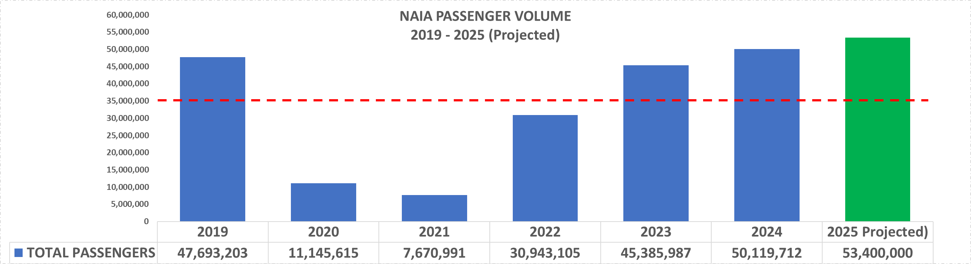
NAIA PASSENGER VOLUME 2019 - 2025 (Projected)
35 million Design Capacity

Slide 7

Setting the Context
NAIA: operating beyond design capacity
Challenge: modernize while serving as the Philippines’ main gateway
Enabled by a PPP framework: NAIA is now under NNIC, a private consortium led by San Miguel Corporation & Incheon Intl. Airport Corp.

Slide 8
CA OBJECTIVES
NAIA PPP BOT: Rehabilitate-Operate-Expand-Transfer
Concession Period 25 years (15-yr base with 10-yr possible extension, subject to KPI review in 8 years) | Concession Agreement Signing Date March 18, 2024 | O&M Start Date September 14, 2024 (180 days from signing of CA)
Objectives
Expand terminal capacity to 62 Million Passengers Per Annum (from 35 MPAX design capacity) | Increase runway capacity to 48 Air Traffic Movements (ATM) Peak Hourly Rate (from 40 ATM)

Slide 9










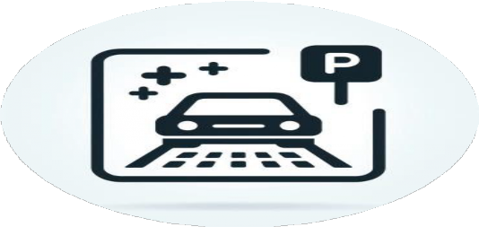

Within 4-5 Years
Increase terminal capacity from 35m to 62m pax/annum
Use of updated Pax Processing Systems (Self Check-in, Self Bag-drop, Biometrics)
World class retail and F&B experience
Runway efficiency from 40 to 48 movements per hour
Efficient passenger terminal transfers
Double the capacity of car parking
New Terminal connecting to T2
Connection of T3 to Metro Manila Subway
Upgraded baggage handling system
10/16/2024 | 19

Slide 10
Laying the Foundations for Digital Transformation
Building digital infrastructure (biometrics, passenger systems, cloud)
Partnering with tech providers for scalable solutions
    Collins – PPS and AMS
    Amadeus – border control/ immigration E-gates
  Made possible through NNIC’s private sector efficiency & long-term investment
  NNIC’s partnership with IIAC brings Incheon’s world-class expertise to NAIA

Slide 11
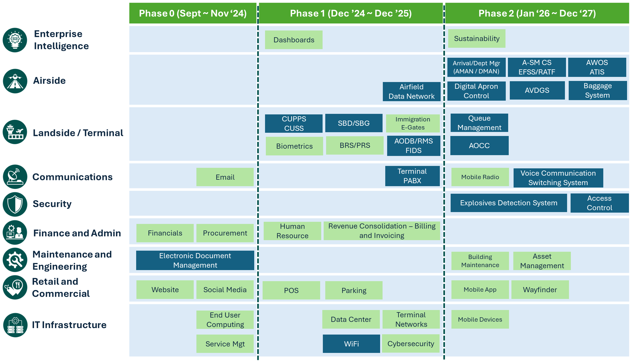
IT SYSTEMS ROADMAP
 | Required under the Concession Agreement
 | To be provided by NNIC above the CA requirements

Slide 12
The Vision of Seamless Travel
Passenger expectations: faster, contactless, secure
Airport operator’s mission: enable frictionless movement
From check-in to boarding: the end-to-end biometric journey

Slide 13
Biometrics as a Single Token of Identity
Eliminates need for physical documents at each checkpoint
Enhances throughput and reduces queuing
Integrated with government and airline systems

Slide 14
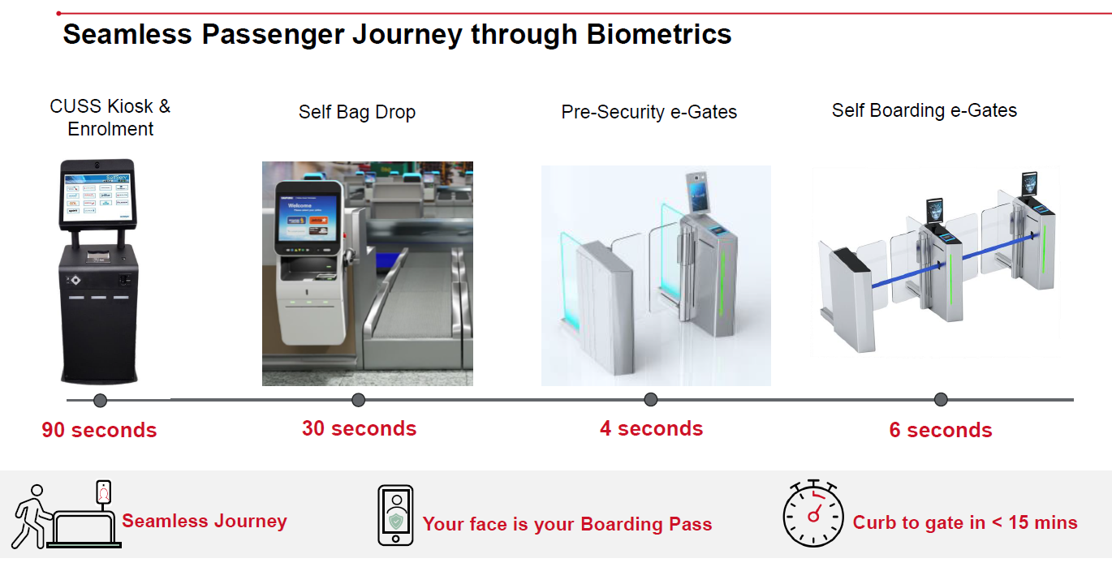
BIOMETRICS JOURNEY

Slide 15
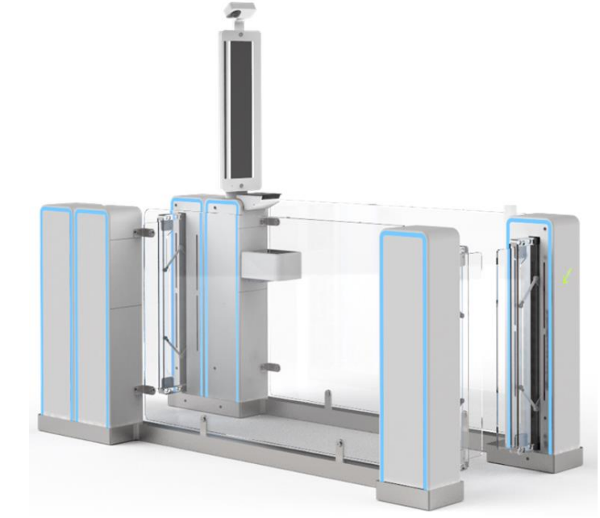
Immigration eGates
A total of 78 2-door (mantrap) Automated Border Control eGates from Amadeus will be deployed across Terminal 1 (18 units) & Terminal 3 (60 units). Phase 1 will see 60 units deployed by Dec 2025.
Business Rules
Only Filipino citizens will be eligible to use the ARRIVAL eGates For the pilot phase, OFWs and eligible foreign passport holders will be able to use the DEPARTURE eGates.
2-door (Mantrap) ABC eGate
Key Features Core components (face capture unit, travel document reader, display, door mechanisms and sensors) protected by metal vandal-proof encasing and panels Automated height adjustment ISO/ICAO Compliant Face Capture

Slide 16
Immigration e-Gates – Smart Border Control
Speeds up immigration processing
Facial recognition + chip passport verification
Reduces manpower and human error

Slide 17


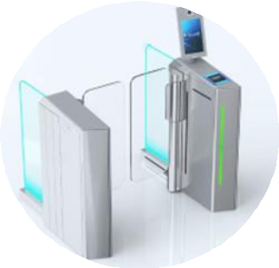


Passenger Processing / Airport Management Systems
Phase 1
(by Q3 2025)
Phase 2
(by Q3-Q4 2025)
Phase 3
(by Q4 2025)
Airport Operational Database (AODB)
Resource Management System (RMS)
Apron Management System (AMS) Process Automation
Common Use Passenger Processing System (CUPPS) (Agent Check-in)
Local Departure Control System (LDCS)
Baggage Reconciliation System and Bag Messaging
24*7 Onsite Support
Common Use Self Service (CUSS) (Check-in Kiosk)
Self Bag Drop
Pre-security Gates
Self Boarding Gates
Biometric Platform
Flight Information Display System (FIDS)

Slide 18
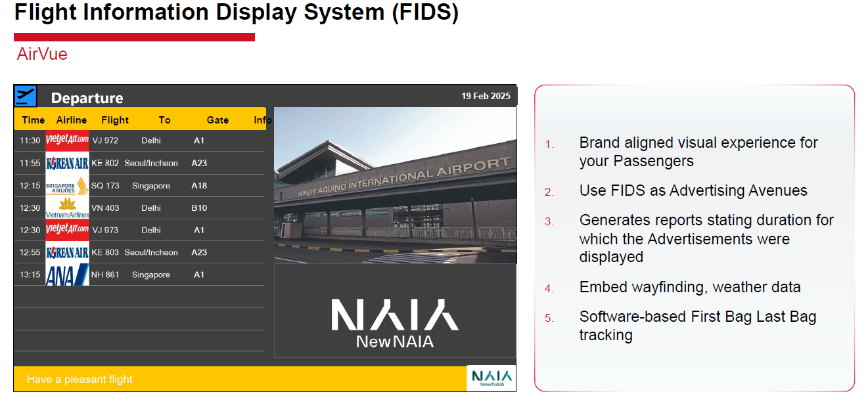
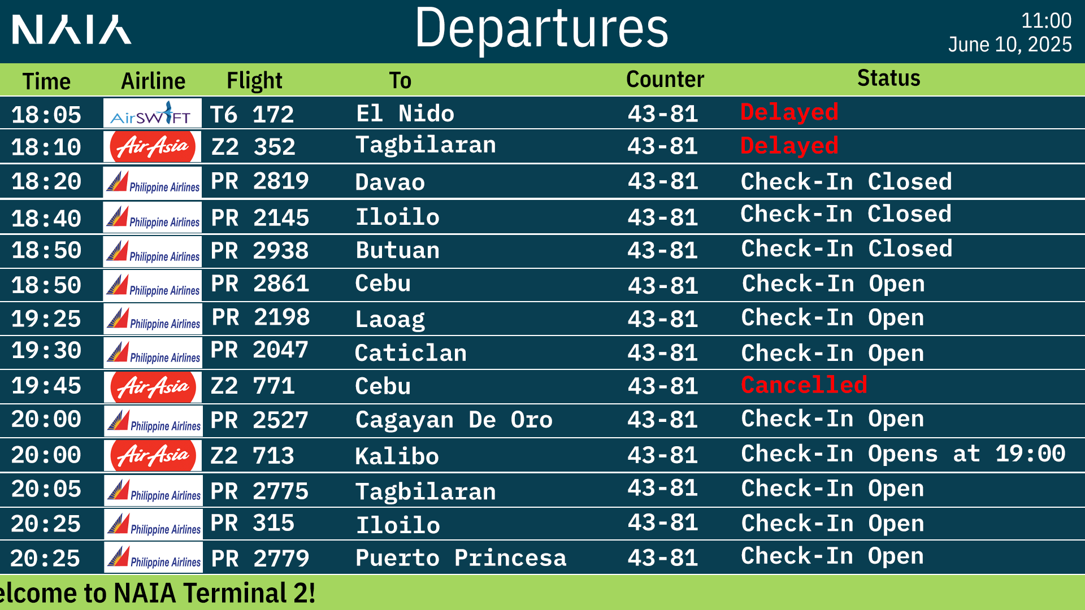
686 FIDS units to be deployed across 3 terminals- Quiet Terminal Concept

Slide 19
Passenger Processing / Airport Management Systems
 | Benefits | Airline Participation Rate
Common Use Passenger Processing System (CUPPS) | Cost effective with less infrastructure investment Flexibility in operations (counter assignment, manning and training, set-up) Improved queue time | 100% of airlines enrolled
Common Use Self-Service (CUSS) | Cost effective with less infrastructure investment and staff requirements Better passenger experience from faster processing and convenience, reduced congestion Supplemental kiosks to staffed airline counters | Only four airlines ready for deployment (PAL, Ceb Pac, Air Asia and Korean Air)
Self-Bag Drop (SBD) |  | Only three airlines have signed on (PAL, Ceb Pac, Air Asia)
Baggage Reconciliation System and Bag Messaging | Real-time updates on baggage status Improved passenger experience and reduced mishandling costs Better operational efficiency for baggage tracking and communication to passengers Improved security compliance

Slide 20
Challenges and Considerations
Infrastructure upgrades and change management
Data privacy and consent
Domestic IDs to be used
System integration: airlines and Immigration
Confirmation that Passengers’ Travel Taxes have been paid
Visa Checks
Show Up Profile

Slide 21
Key Technologies Enhancing Passenger Experience
Biometric Identity Management (facial recognition)
Immigration e-Gates (automated border control)
Passenger Reconciliation System (real-time pax tracking)
Self-Boarding Gates (paperless boarding)
Self-Bag Drops
Mobile & Contactless Payments

Slide 22
Benefits to Stakeholders
Passengers – Shorter wait times, contactless journey
Airlines – Faster boarding, fewer missed connections
Immigration – Secure and accurate processing
Airport Operations – Improved throughput and better OTP

Slide 23
Closing Thought: From Catching Up to Leapfrogging
NAIA’s digitalization journey is just beginning
PPP gives resources + expertise to leapfrog
San Miguel’s Corp’s scale + IIAC’s global know-how
Digitalization allows delivery of future-ready, world-class travel

Slide 24
CONCLUSION
Seamless travel is no longer optional—it’s expected
Tech investments = competitiveness and passenger satisfaction
Let’s make air travel safer, faster, smarter

Slide 25
Thank You!

